Slide 1

Pipe Overflow Prediction Model in Stormwater Networks and Visualization Using Mixed Reality
SeyedMojtaba Noghabaei
North Carolina State University

Slide 2

Outline
Introduction
Background and Objective Statement
Observed problems
Research Objective
Methodology
Proposed solution
Results

Slide 3
Definition of Smart Cities and Application Area
A smart city is an urban area that uses different types of electronic data collection sensors to supply information which is used to manage assets and resources efficiently.

Slide 4
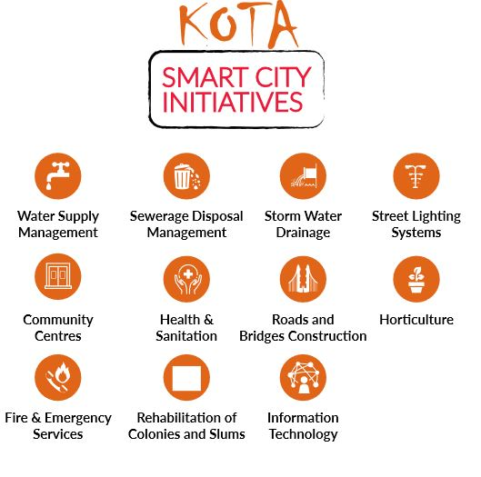
Definition of Smart Cities and Application Area
Data from devices
Data from citizens
Data from assets
Data processing

Slide 5
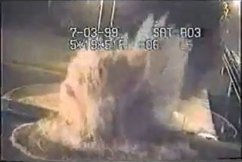
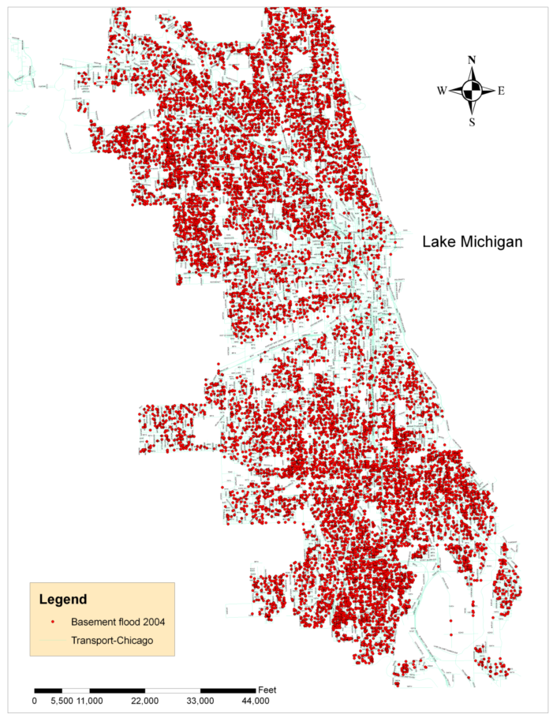
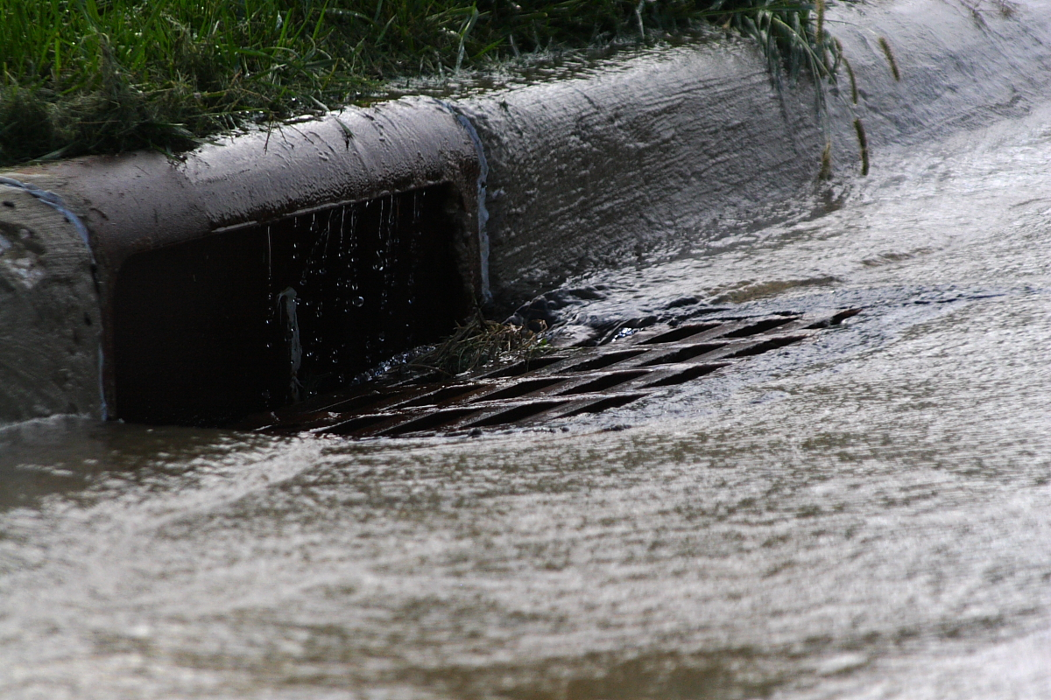

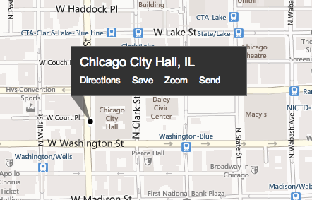
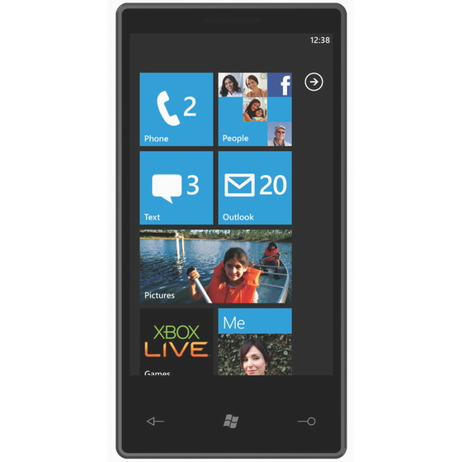
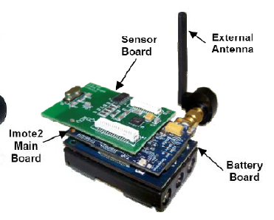

Observed Problems
Overflow in stormwater networks
Drainage
Overflow
Stormwater flow monitoring via low-cost sensor networks and social networking.
Basement flooding complaints documented in Chicago during 2004

Slide 6
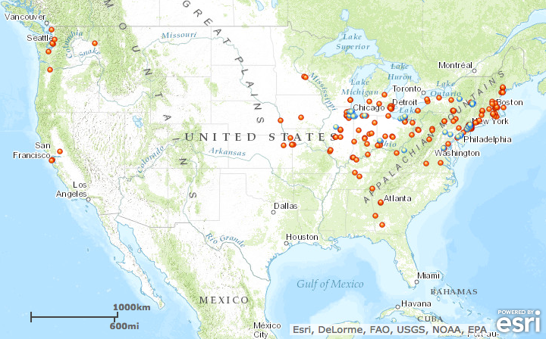
Observed Problems
Water Problems Elsewhere
Is it possible to predict overflows?

Slide 7
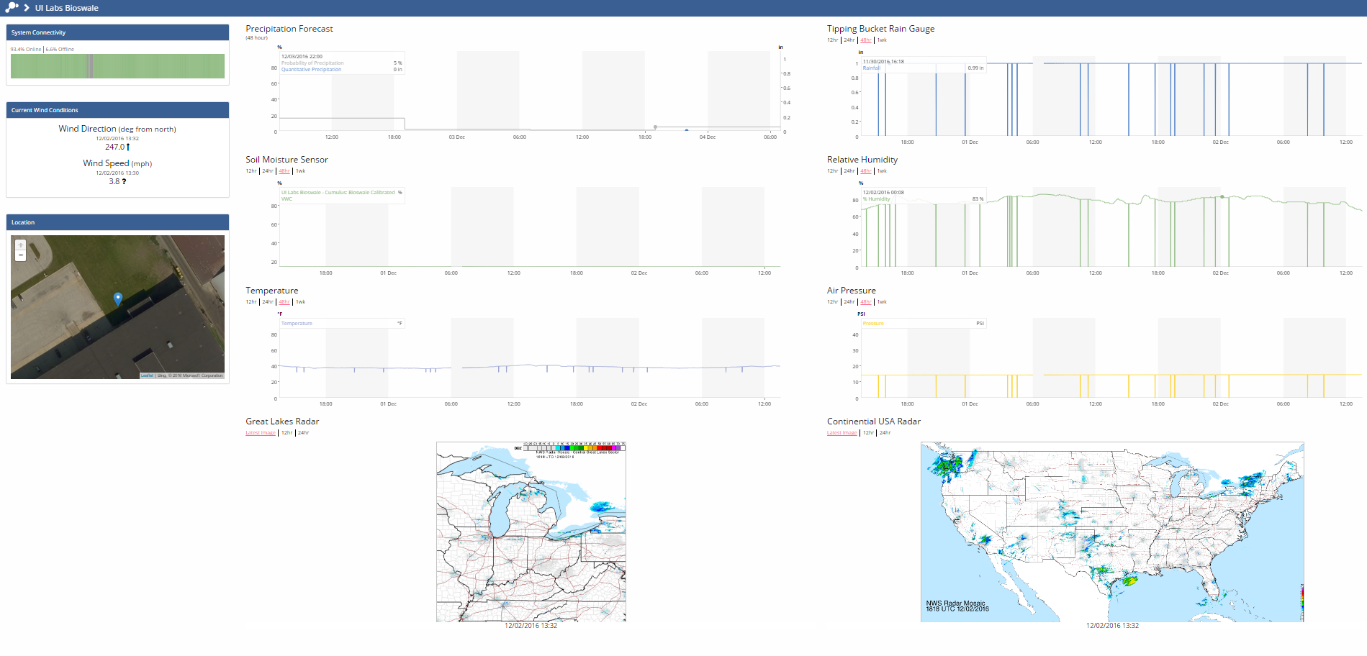
Visualization and Sense-Making
Current visualization approaches for smart cities data
Notes:
Best decisions
Allocating resources during a disaster

Slide 8
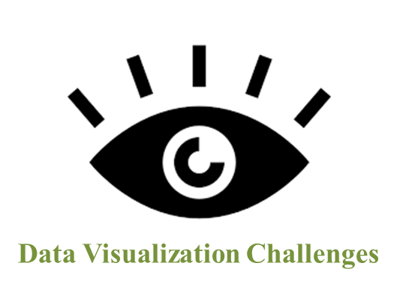
Data Visualization Challenges
Limited field of view of objects
Lack of real-time data dissemination
Lack of features enabling collaboration
Notes:
One of the things that we can use is MR technology

Slide 9
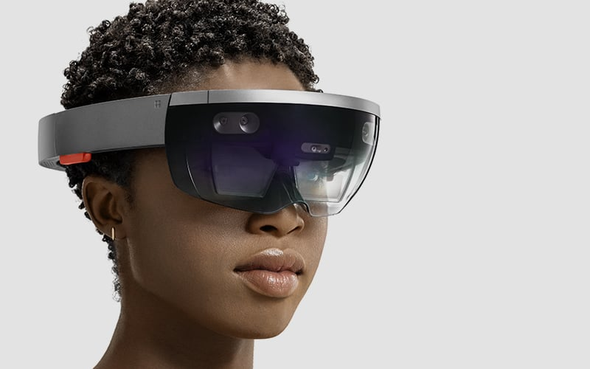
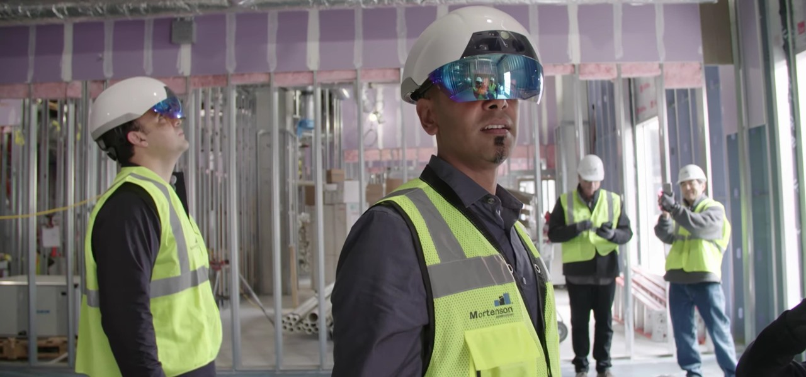
Data Visualization Challenges
Smart visualization is the First step toward becoming a truly smart city*
*Jan-Philipp Mohr(2017) “IMMERSIVE DATA VISUALIZATION FOR SMART CITIES”
Notes:
One of the things that we can use is MR technology

Slide 10
Why Mixed Reality?
Mixed Reality allows to see at different scale, from different perspective.
Helps for optimal actions and decisions
When we see things we make progress
Allow to live experience in augmented and virtual environments
Digital twin technology is useful for looking forward to minimize the labor and cost.
Notes:
We understood that visualization is important, but why MR ?

Slide 11


Why Mixed Reality?
Why Mixed Reality?
Notes:
We understood that visualization is important, but why MR ?

Slide 12
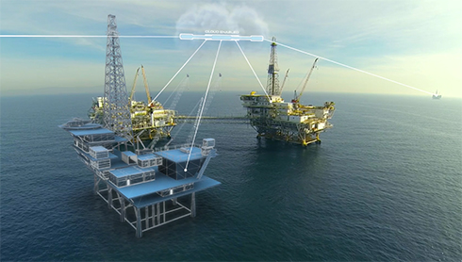
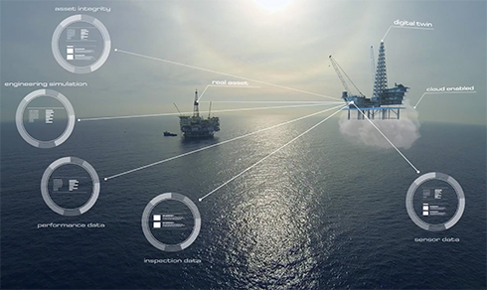
Why Mixed Reality?
Notes:
We understood that visualization is important, but why MR ?

Slide 13

Why Mixed Reality?
AR/VR offer large possibilities to visualize complex urban systems, to live and share urban experience, to create emotional environment, to learn, to understand, to act together for the city.

Slide 14
Research Objectives
Create a platform to predict overflows in order to help utility managers before disasters.
Create a digital twin for the stormwater network and enable utility managers for better decision making using Mixed Reality technology.

Slide 15
Research Method
Data from previous overflows or SWMM
Create models for predicting overflows
Visualize in a twin MR model

Slide 16
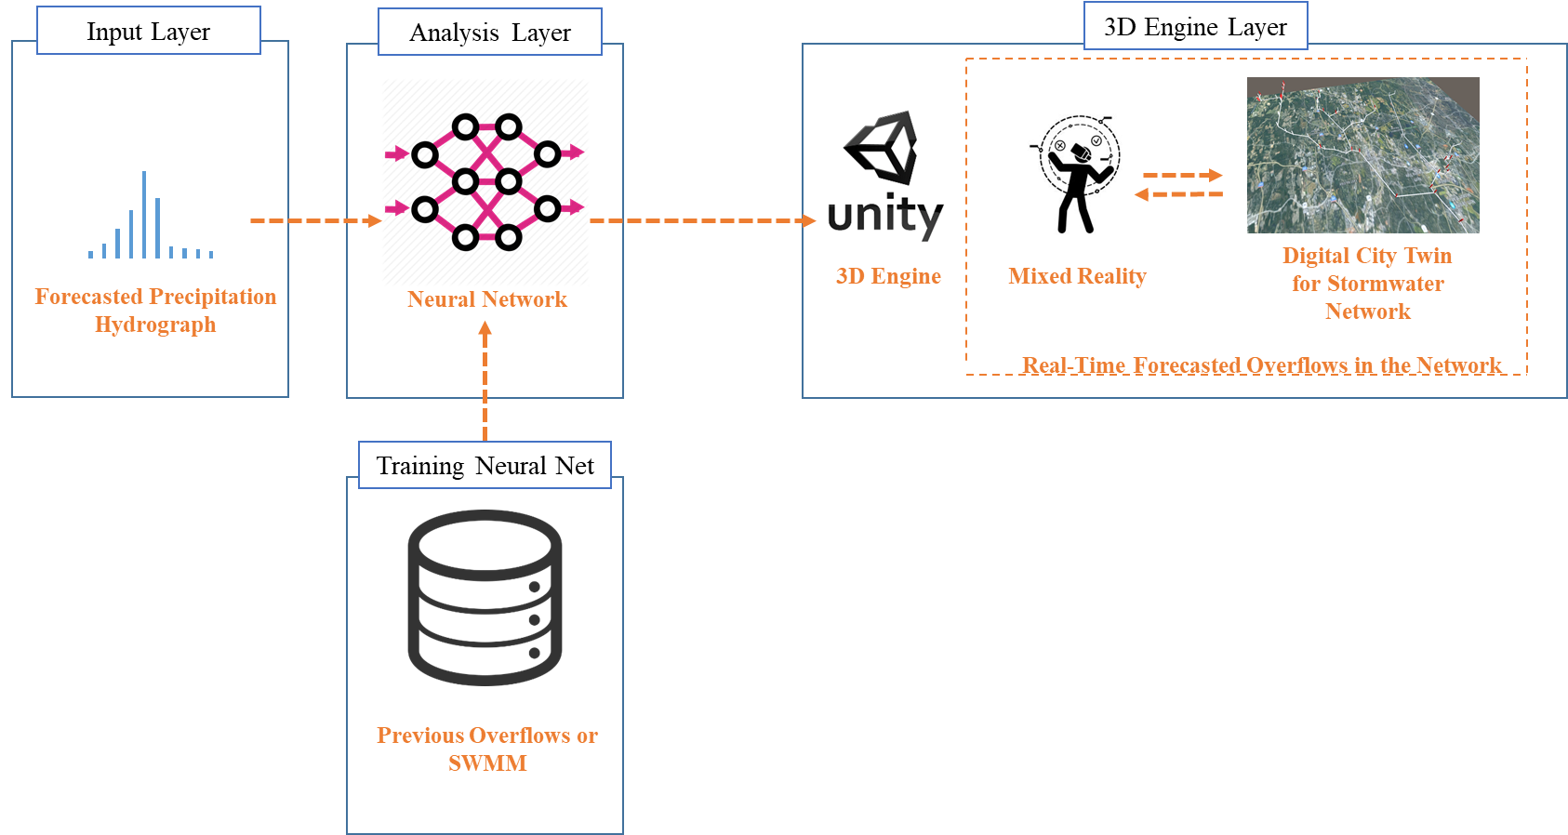
System Architecture

Slide 17
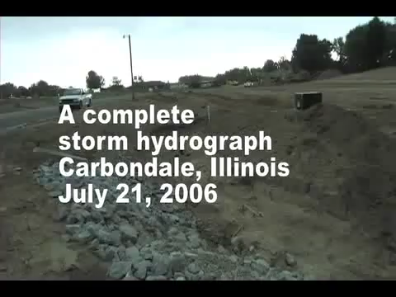
Which Precipitations Cause Overflow Problems
Notes:
40 Seconds

Slide 18
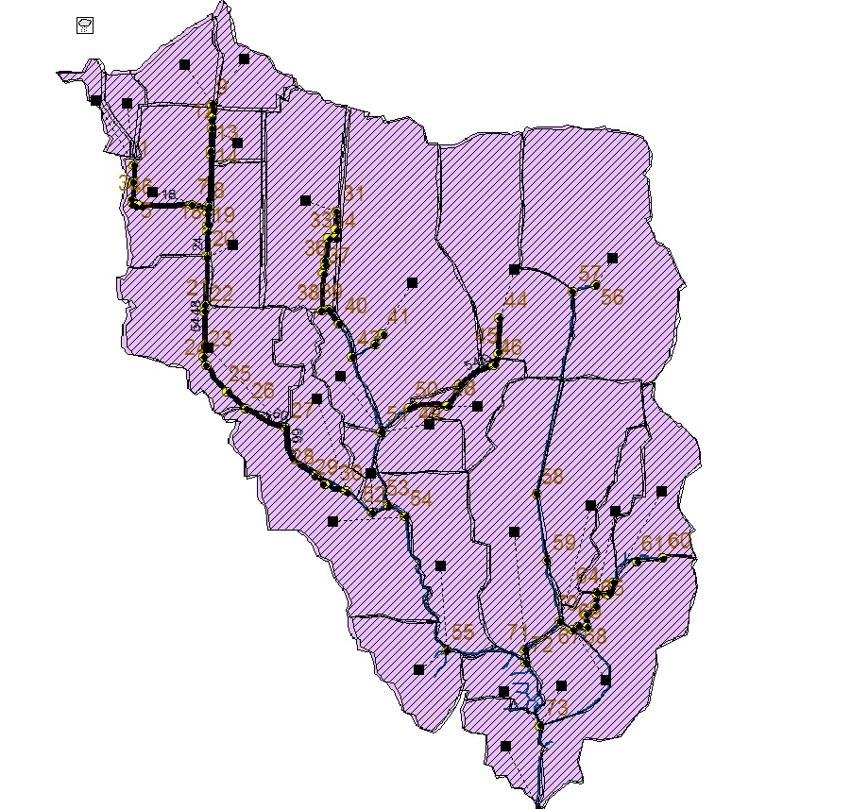
Training Data
Run SWMM for 150 of different precipitations and find pipes or junctions with overflow problems
5 minute sampling hydrographs
All data is from city of Raleigh

Slide 19
Which Precipitations Cause Overflow Problems
Precipitation hydrograph
Precipitations with high peak

Slide 20
Make The Precipitation Shape More Simple
Simplify hydrograph with four numbers
Var. 2
Var. 1
Var. 3
Var. 4 (time)

Slide 21
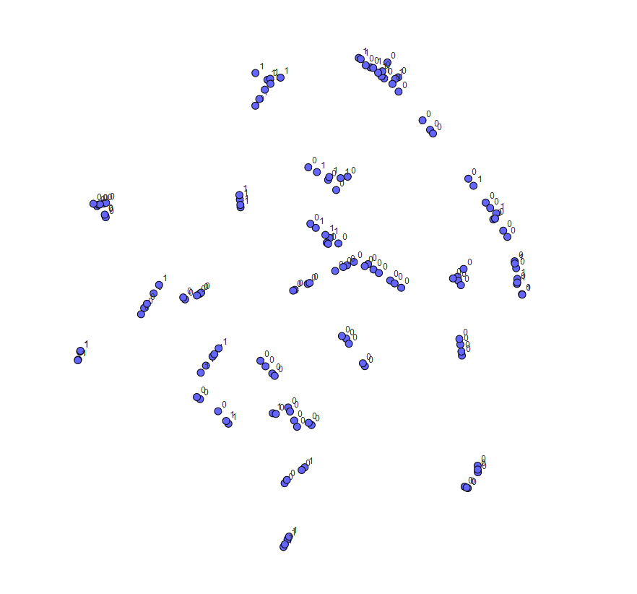
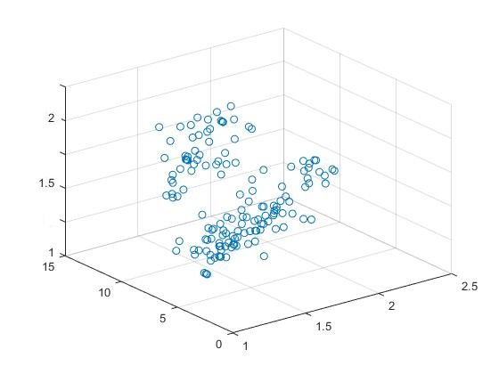
Data
Dataset (150 different hydrographs)
3 factor plotting
t-SNE chart

Slide 22
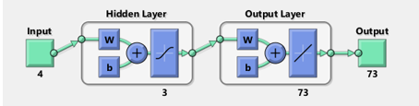
NN Training
Neural net fitting
4 inputs for each hydrograph
3 hidden layers
73 outputs for each junction in network(1 or 0)

Slide 23
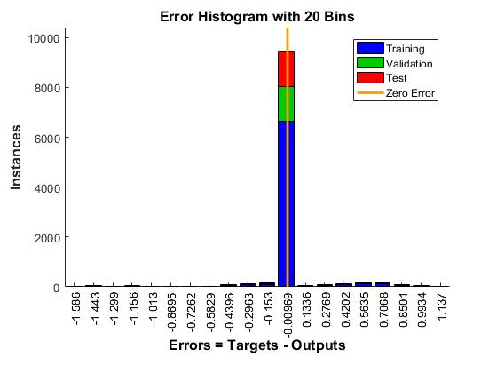
NN Results
70% training
15% validation
15% test

Slide 24
NN Results
MSE = 0.0614
R-MSE = 0.078 inches
R = 8.63e-1
Mean Squared Error is the average squared difference between outputs and targets. Lower values are better. Zero means no error.
Regression R Values measure the correlation between outputs and targets. An R value of 1 means a close relationship, 0 a random relationship.

Slide 25
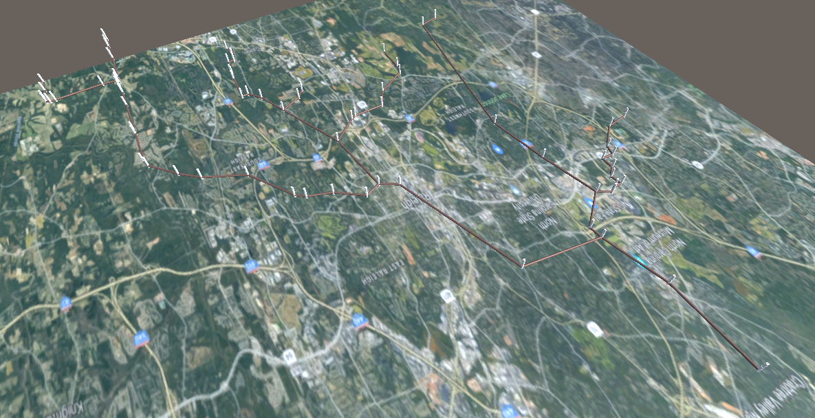
Unity Model
Water Flow Mapping

Slide 26
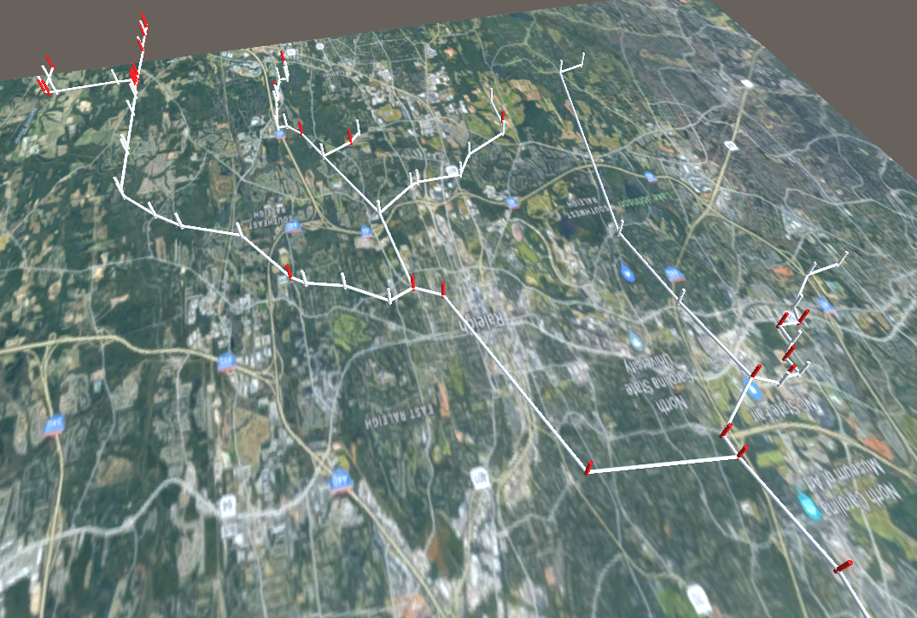
Results
Real-time over flow prediction platform
Test a totally new test with just one misclassification
Neural Net
Forecasted hydrograph
Predicted overflow pipes in MR environment

Slide 27
Results
Is it possible to predict overflows?
The results of this study shows how we can use data collected by sensors to improve management and predict overflows.

Slide 28
Discussion
How your results answer the question that you identify in the background, “What has not been done in this area of research”
How do the results of your project help advance smart city applications
What is a vision for how you or other researchers could build on the results you have demonstrated and develop a complete smart city application

Slide 29
Discussion and Vision
Efficient stormwater management
Rapid and ahead of time response in emergencies
Efficient disaster management
We can use this approach in other areas smart cities like traffic, water network, and natural gas network.

Slide 30
Limitation
Identify at least one criticism of smart cities that you identify from the literature and include citation
Does your project show evidence to support this criticism, or does it leave that criticism un addressed
What is the limitation of your project
How could future work that builds on your project address criticisms or limitations of smart cities applications

Slide 31
Limitation
It is a predicted model and cannot detect issues caused by extraordinary events
How we can use our resource in an optimal way?

Slide 32
Conclusion
Summarize what you have done what are your findings and what are your contributions

Slide 33
Conclusion
The problem was predict overflow and visualize it in a better way
We used different types of neural networks and tested them and reported the best one
Finally we were able to train a neural network model using the our data and predict overflow and visualize it in a digital twin model of network

Slide 34
Thank You

